Slide 1

CS6030 - NATURAL LANGUAGE PROCESSING SPEECH EMOTION RECOGNITION
- Presented by
Balaji S (2018103014)
Dhananjeyan A K (2018103523)

Slide 2
INTRODUCTION:
The human voice is very versatile and carries a multitude of emotions. Emotion in speech carries extra insight about human actions. Through further analysis, we can better understand the motives of people, whether they are unhappy customers or cheering fans. Humans are easily able to determine the emotion of a speaker, but the field of emotion recognition through machine learning is an open research area.

Slide 3
OBJECTIVES:
The main objective is to enable computers to understand the emotional states expressed by the human subjects, so that personalized responses can be delivered accordingly in the cases of voice assistance and recommendation systems.
DATASET:
Input signals are from Ryerson Audio Visual Database of Emotional speech and song (RAVDESS) against classifier models. (24 actors).
Surrey Audio Visual Expressed Emotion (SAVEE) dataset

Slide 4
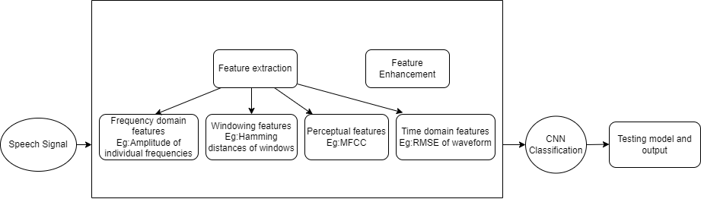
METHODOLOGY DIAGRAM:
Converting audio files into Machine understandable format.(Data preparation)
using Sampling and frequency domain plotting.
Data preprocessing – Extracting features from audio using Librosa and preparing for CNN –Features extracted using algorithms of MFCC , MEDC
Features are then extracted using windowing techniques.

Slide 5
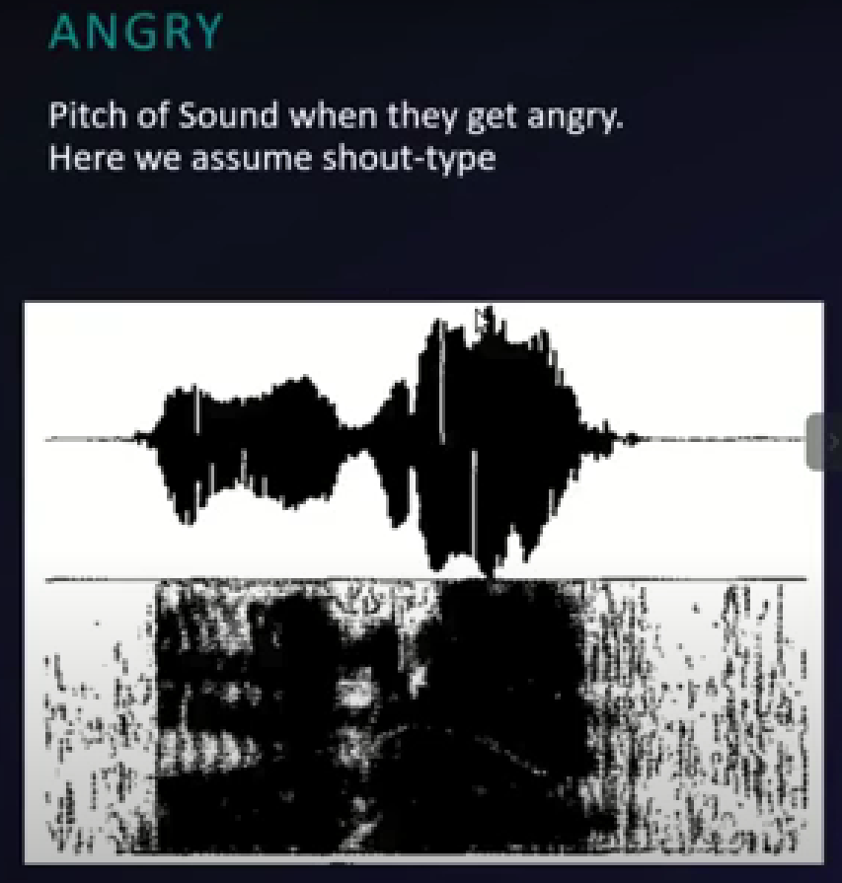
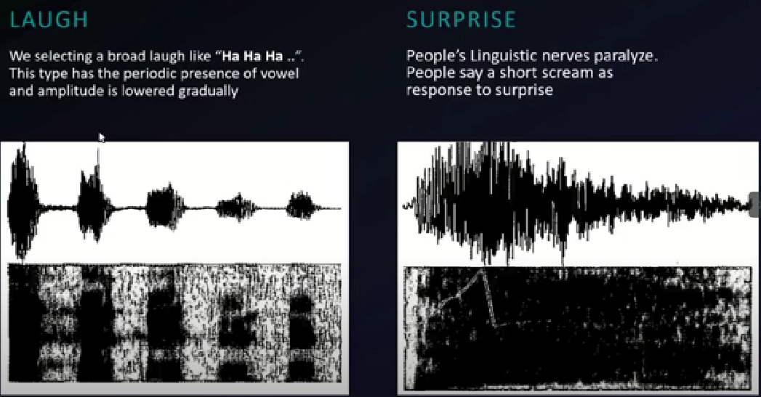

METHODOLOGY CONTD.
SER Model Creation (CNN)
Model Training and Evaluation
Test set prediction using loaded model
Testing with audio data

Slide 6
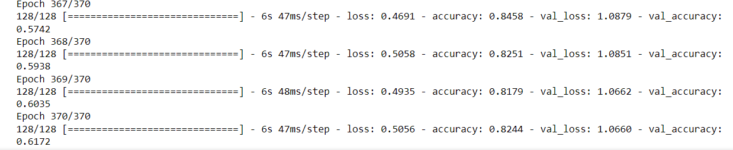
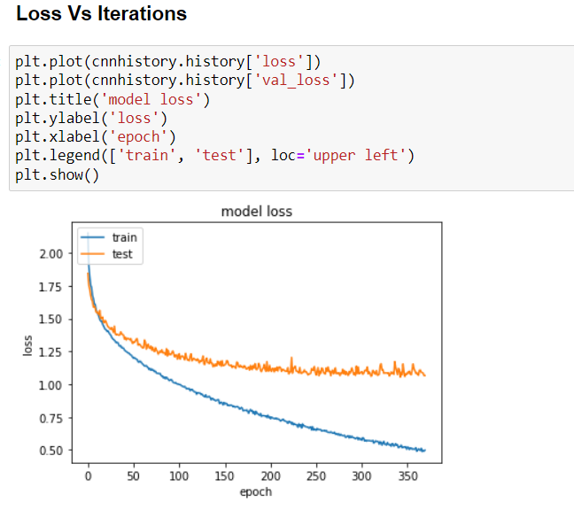
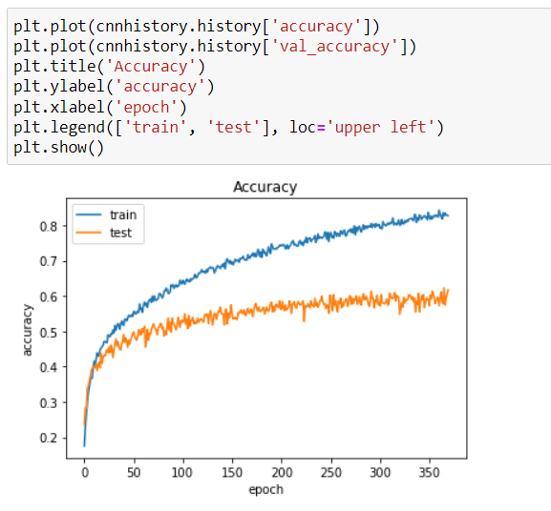
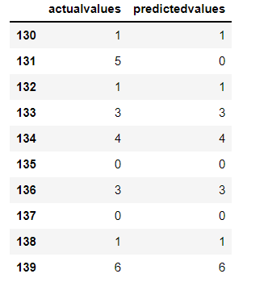
PERFORMANCE:
Val Loss and accuracy
Accuracy – 61.7%

